Slide 1

Phase5 SW Release Plan
Roger Xu, Jiajia Zhou, James Chen
Date: Dec 11, 2020
Desired Outcome
Awareness
Decision
Escalation Help
Think
Point of view
Plan to Implement
Implement

Slide 2
Phase 5 Vehicles Timeline
2021 | 2022 | 2023
1 | 2 | 3 | 4 | 5 | 6 | 7 | 8 | 9 | 10 | 11 | 12 | 1 | 2 | 3 | 4 | 5 | 6 | 7 | 8 | 9 | 10 | 11 | 12 | 1 | 2 | 3 | 4 | 5 | 6 | 7 | 8 | 9 | 10 | 11 | 12
CDX707
UPV1
UPV2
PA
FDJ
DCV
PEC
FEC
TT
PP
MP1
05/28
01/19
02/19
06/30
08/06
05/30
08/09
11/09
02/01
CDX747
07/11
UPV0
UPV1
UPV2
FDJ
DCV
PEC
FEC
TT
PP
MP1
MP2
OK2B
11/23
03/13
06/12
11/06
03/12
06/11
09/24
01/07
07/11
10/26
12/12
10/09
CX788（Study）
UPV0
UPV1
UPV2
PA
FDJ
HB/DCV
PEC
FEC
TT
PP
MP1
OK2B
12/07
05/18
09/16
11/04
04/26
06/21
05/10
07/26
11/17
11/04
01/24
Lincoln Version
10/15
Supplier Integration
Ford Version
Supplier Integration
Key New Feature

Slide 3
CDX707 SW Release Plan
2021 | 2022 | 2023
1 | 2 | 3 | 4 | 5 | 6 | 7 | 8 | 9 | 10 | 11 | 12 | 1 | 2 | 3 | 4 | 5 | 6 | 7 | 8 | 9 | 10 | 11 | 12 | 1 | 2 | 3 | 4 | 5 | 6 | 7 | 8 | 9 | 10 | 11 | 12
CDX707 VPP
UPV2
UPV1
PA
FDJ
DCV
PEC
FEC
TT
PP
MP1
02/19
05/28
06/30
08/06
01/19
05/30
07/11
08/09
11/09
02/01
CDC AHU HW
07/10-08/05
10/15-12/15
05/15-06/15
Pre-DV
B0 DV1
10/05
DV1
DV2
A0 PCBA
01/07
A1 PCBA
04/30
A2 Pre-DV
06/30
B1 DV2
04/15
Display(23.6+23.6,11.1 touch)
09/30-10/30
12/05-12/11
23.6 Pre-DV
03/22-06/09
11.1 EMC
23.6 DV
GPDS SW Version for MRD
DCV Beta
07/20
DCV2
12/19
R04
06/15
DCV0
09/20
DCV1
11/05
DCV3
02/19
R00
04/30
R05
07/16
R06
10/09
R07 01/01
SW Release for REC
R0
02/07
R1
03/08
R2
04/07
R3
05/07
R4
06/07
R5
07/07
R6
08/06
R7
09/07
R8
10/07
R9
11/08
R10
12/07
R11
01/07
R12
02/15
R13
03/15
R14
04/15
R15
05/16
R16
06/15
R17
07/15
R18
08/15
R19
09/15
R20
10/20
R21
12/20
R22 for OKTB
02/20
Package 1-HW+Base SW
R22 for OKTB
01/14
R0
01/14
R1
02/14
R2
03/14
R3
04/14
R4
05/14
R5
06/14
R6
07/14
R7
08/14
R8
09/14
R9
10/14
R10
11/14
R11
12/14
R12
01/14
R13
02/23
R14
03/23
R15
04/23
R16
05/23
R17
06/23
R18
07/23
R19
08/23
R20
09/28
R21
11/28
Package 2-Ford core service
R22 for OKTB
01/07
R0
01/07
R1
02/07
R2
03/07
R3
04/07
R4
05/07
R5
06/07
R6
07/07
R7
08/07
R8
09/07
R9
10/08
R10
11/07
R11
12/07
R12
01/07
R13
02/15
R14
03/15
R15
04/15
R16
05/15
R17
06/15
R18
07/15
R19
08/15
R20
09/21
R21
11/21
Package 3-Eco APPs
R22 for OKTB
01/14
Eng version for vendor’s internal release and test.
R0
01/14
R1
02/14
R2
03/14
R3
04/14
R4
05/14
R5
06/14
R6
07/14
R7
08/14
R8
09/14
R9
10/14
R10
11/14
R11
12/14
R12
01/14
R13
02/23
R14
03/23
R15
04/23
R16
05/23
R17
06/23
R18
07/23
R19
08/23
R20
09/28
R21
11/28
Inhouse APPs
Eng version not necessary to release.
R22 for OKTB
01/14
Pro version released for REC, focus and lite test.
R0
01/14
R1
02/14
R2
03/14
R3
04/14
R4
05/14
R5
06/14
R6
07/14
R7
08/14
R8
09/14
R9
10/14
R10
11/14
R11
12/14
R12
01/14
R13
02/23
R14
03/23
R15
04/23
R16
05/23
R17
06/23
R18
07/23
R19
08/23
R20
09/28
R21
11/28
Package 4-HMI
Pro version released for REC, full test.
Group A for R2 12/20
Group B
Group C
Group D

Slide 4
CDX707 R0-R5 FIP

Slide 5
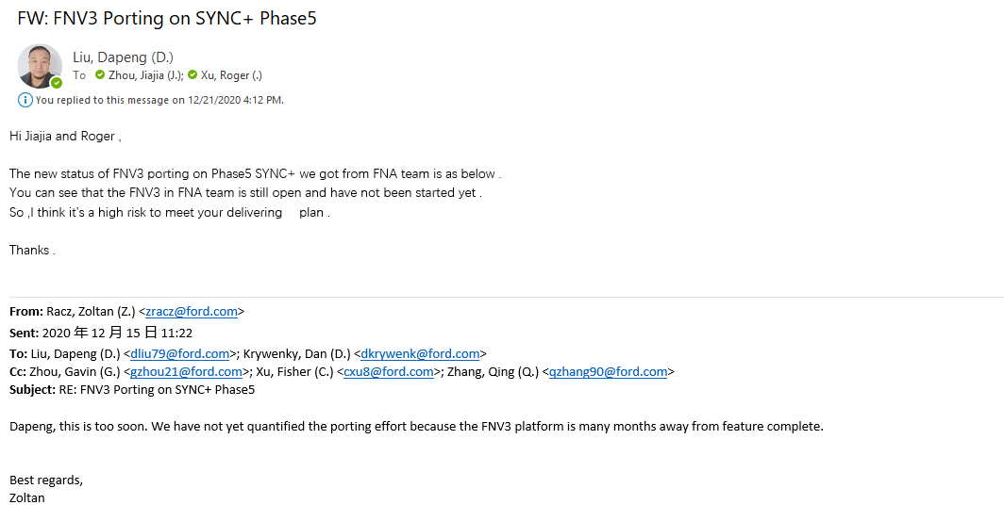
CDX707 R0-R5 FIP
1.Autosar License---RFQ
2.FNV3 Readiness---NA
3.HMI
4.FO Definition
5.Bench R&R

Slide 6
CDX707 SW FIP—R2 Release Plan
12/7 | 12/14 | 12/21 | 12/28 | 01/04 | 01/11 | 01/18 | 01/25 | 02/01 | 02/08 | 02/15 | 02/22 | 03/01 | 03/08 | 03/15 | 03/22
System UI
SPSS/PRD Release and frozen from FO
12/17
MRD Review with FO
12/18
MRD Sign off with FO 12/22
UI/UE Release
12/25
Test case Sign off with FO 01/07
Code Release and integration
03/07
Coding
12/26
收音机 Radio
SPSS/PRD Release and frozen from FO
12/30
MRD Review with FO
01/06
UI/UE Release
01/07
MRD Sign off with FO 01/12
Coding
01/13
Test case Sign off with FO 01/26
Code Release and integration
03/07
Log system-串口
SPSS/PRD Release and frozen from FO
12/30
MRD Review with FO
01/06
UI/UE Release
01/07
MRD Sign off with FO 01/12
Coding
01/13
Test case Sign off with FO 01/26
Code Release and integration
03/07
FPD Link
SPSS/PRD Release and frozen from FO
12/30
MRD Review with FO
01/06
UI/UE Release
01/07
MRD Sign off with FO 01/12
Coding
01/13
Test case Sign off with FO 01/26
Code Release and integration
03/07

Slide 7
CDX707 Open Issue list—12/18 update
No | Topic/Issue | Assignee | Due date | Status
1 | 12/11: Input the last MFL including FDL and Pre-DV Dependency list for Vendors(YF/Baidu/inhouse) to review and confirm. Set daily meeting to review MFL with vendors(Group,Pre-DV List， FDL, Release Version), target to freeze the MFL COB 12-20. 12/14 Jzhou101：The latest MFL has been confirmed and obtained from planning/program team today, Pre-DV SW release version and FDL will be imported before 12-16 by James, targeting to review with vendors again on this Thursday’s weekly meeting(10:00-11:00am). 12/18：Action Plan: 12/21 Define and confirm the pre-dv dependency list with D&R and vendors; 12/22 Follow up all the open issue of FIP; 12/24 Confirm FO; 12/25 Frozen and Release Master Feature List which with the Aligned FOs; 12/28 Define the UI/UE release plan with HMI team. | Chen James， Huang Feng, Zheng Wei | 12/18/2020 | Y
2 | 12/11: FO of different features has not confirmed yet, influencing SPSS release and the R0 release. Help Needed! 12/18：LL6 Check and align the FO (Lead by each LL6, coordinated by PMT) | Chang Cathy, Xu Fiona | 12/24/2020 | Y
3 | 12/11: High risk for No HMI vendors onboard, Need YFVE confirm the deadline dependence. HMI team escalate this risk. 12/16：Group A draft UE will be released to REC on 12-20, vendors will be on-board within this week. 12/18:HMI team plan to discuss with HMI vendors and define the UI/UE release plan for R0-R5. Supporting Pre-DV. | Sun Xiao | 12/18/2020 | Y
4 | Fnv3 risk, can not support pre-DV. 12/18: Inhouse has followed this issue and try to find ICA/PCA internally. | Zheng Wei | 21-Dec | R

Slide 8
Phase5 SW Maturity Requirement
Phase5 SW Maturity Requirement
DCV beta | System test on engineering prototype/ Bench | eBB MRD | Support FDJ
DCV 0 | Fully verified on component level | DCV BB MRD - 2 weeks | support BB MRD
DCV 1 | Updates Release | T/C MRD - 4 weeks | support DCV MRD
DCV 2 | Updates Release | DCV - 2 weeks | sw improvement
DCV 3 | Updates Release | DCV+ 4 weeks | support DCV
R00 | Feature DV complete. | PEC - 3 weeks | support PEC
R04 | Feature DV signed off | FEC - 3 weeks | support FEC
R05 | Fully Validated Release | TT MRD -3 weeks | support TT
R06 | Fully Validated Release | PP MRD - 3 weeks | support PP
R07 | Fully Validated Release | MP1/J1 MRD - 3 weeks | support MP1

